Slide 1

ACT English Test 1165D
75 questions, 45 minutes
Usage/Mechanics
53% of the test
Punctuation, Grammar & Usage
Sentence Structure

Slide 2

ACT English Test
75 questions, 45 minutes
      Rhetorical Skills
      47% of the test
      Strategy-Style
      Organization

Slide 3
STRATEGIES FOR THE ENGLISH SUBTEST
Be aware of the Writing Style used in the essay.
Some are narratives written in 1st person, more informal
Others are scholarly essays, often written in 3rd person
Some questions may require you to choose an answer based on tone

Slide 4
Consider a Question’s Context Before You Choose an Answer
Some people find it most useful to skim an essay and its questions before trying to answer any of them.
Many people don’t have time to skim the whole passage but you can NOT just look at the underlined portion.
As you’re answering a question be sure to read a sentence or two beyond the portion underlined in order to better determine context.

Slide 5
Be Aware of the Connotations of Words
Vocabulary isn’t tested in an isolated way on the ACT English test.
You will need to use context clues and careful reading to focus on what the words mean and what associations they have for a typical reader.

Slide 6
Examine the Underlined Portions
Note the differences in the answer choices.
Avoid correcting mistakes in the essay and accidentally making a new mistake.
Determine the best answer in one of two ways---try each one or decide on your own and find the one that matches most closely.
CROSS out answers you elimate

Slide 7
Double-check your answer
Once you have selected the answer you believe is best, reread the sentence or sentences, substituting your answer for the underlined or boxed portion of the test.
Boxed questions refer to whole parts of sections of the essay or passage.

Slide 8
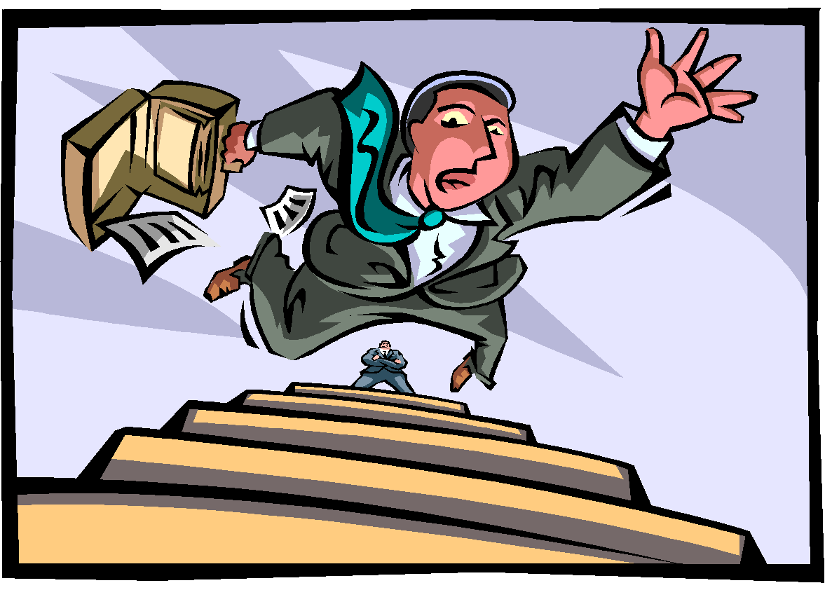
Watch out!
Be careful with two part questions. Remember to look back.
Watch for interrelated questions. You may need to consider questions in a different order. Or you may need to consider two questions together.

Slide 9

BE CONCISE!!!
LOTS of ?’s Address This!
Often times the shortest answer is correct
Avoid Wordiness or Redundancy
Example from a DIFFERENT test
….it occurred to me that each species was the consequenting result of genetic selection
    correct answer is …..was the result of
    Consequently and Result Of mean the same thing

Slide 10

READ ?’s CAREFULLY - Even if you feel like you are in a bit of a hurry
Some ?’s may ask for the one that is INCORRECT or that would NOT work! Statistically speaking these are tough.
Many of the questions ask which one provides the most SPECIFIC description or evidence -- generally they are looking or concise answers but not when they ask for SPECIFICS

Slide 11
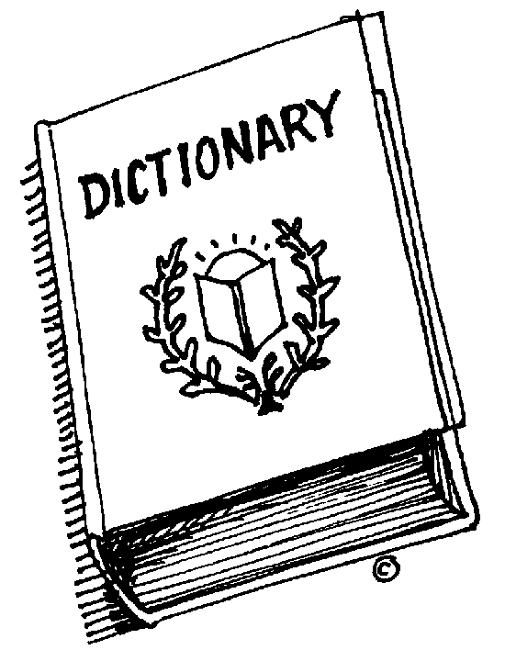
TRANSITIONS
In order to select the correct transitional or connecting word, you need to look at the CONTEXT.
Example:
Contrasting Ideas: however, conversely, etc.
Supporting Ideas: Therefore, For example, In fact, As a result, etc.

Slide 12
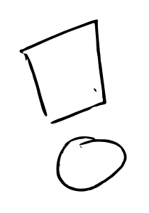

Usage/Mechanics
Punctuation questions involve identifying and correcting misplaced, missing or unnecessary punctuation marks:
Commas
many unneeded commas
Apostrophes
Colons, semi-colons, and dashes
Periods, question marks, exclamation points

Slide 13
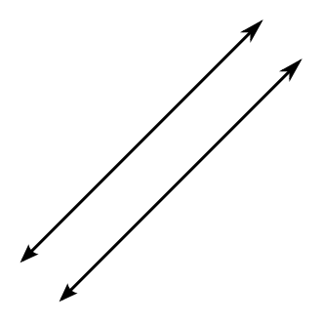
Parallel Structure
(requires looking at context)
Make sure items in a list are in the same format.
We went biking, fishing, and swimming.
I want to clean my room, pack my clothes, and visit my family.
Singing, dancing, and running always make me happy.

Slide 14

Here is an example of Parallel Structure from a DIFFERENT TEST
Everything should be in the same format & structure
It is her blanket at night, being her pillow for mid-afternoon naps, and her towel after bathing.
A) NO CHANGE
B) used for a pillow for mid-afternoon naps
C) for mid-afternoon naps it is her pillow,
D) her pillow for mid-afternoon naps (CORRECT)

Slide 15

Grammatical Agreement
Subject and Verb Agreement
The owner of the bicycles are going to sell them.”
Should be
The owner of the bicycles is going to sell them.”

Slide 16
Pronoun and Antecedent
“Susan and Mary left her briefcases in the office.”
should be
“Susan and Mary left their briefcases in the office.”

Slide 17

Agreement Check for Understanding
Agreement is one of the trickier concepts. Do you think you have it? Many other things affect it (the use of and/or, the use of tricky words, etc.). There are much tougher examples. Let’s find out how well you get it!
Take a break from listening and start interacting! Good Luck! CLICK HERE
We’ll check out some practice
test questions later.

Slide 18
Adjectives and Adverbs
“Danielle spread frosting liberal on the cat.”
“liberal” is an adverb-it modifies spread which is a verb
Adverbs almost always end in “ly”
should be
“Danielle spread frosting liberally on the cat.”

Slide 19

Verb Forms
“Fritz had just began to toast Lydia’s marshmallows when the dog howled.”
wrong tense-should be
“Fritz had just begun to toast Lydia’s marshmallows when the dog howled.”

Slide 20
Pronoun Forms and Cases
“Seymour and Sue annoyed there parents all the time.”
wrong one-should be
“Seymour and Sue annoyed their parents all the time.”

Slide 21
There-Their-They’re
There-an adverb used to point out location…There is a big dog under the porch.
Their-a possessive personal pronoun…Their books need to be covered.
They’re-a contraction for “they are”…
They’re late for the basketball game.

Slide 22


THAN vs THEN
THAN - compares
You would like to be compared to an “A” student - thAn
He is funner than she is.
THEN - time
First we will go shopping; then we will go for lunch.

Slide 23

Sentence Structure Errors
Subordinate or dependent clauses
Run-on sentences
Comma splices
Sentence fragments
Misplaced modifiers
Shifts in verb tense
Parallel structure

Slide 24
Adjectives and Adverbs
Question #17
Adjectives modify nouns; adverbs modify verbs, adjectives, and other adverbs.
You can recognize adverbs easily because many of them are formed by adding -ly to an adjective.

Slide 25

Question #17
#17 The orange and black monarch butterfly, which is the most easiest recognized and striking butterfly species in North America...
NO CHANGE
most easy
easiest
most easily

Slide 26
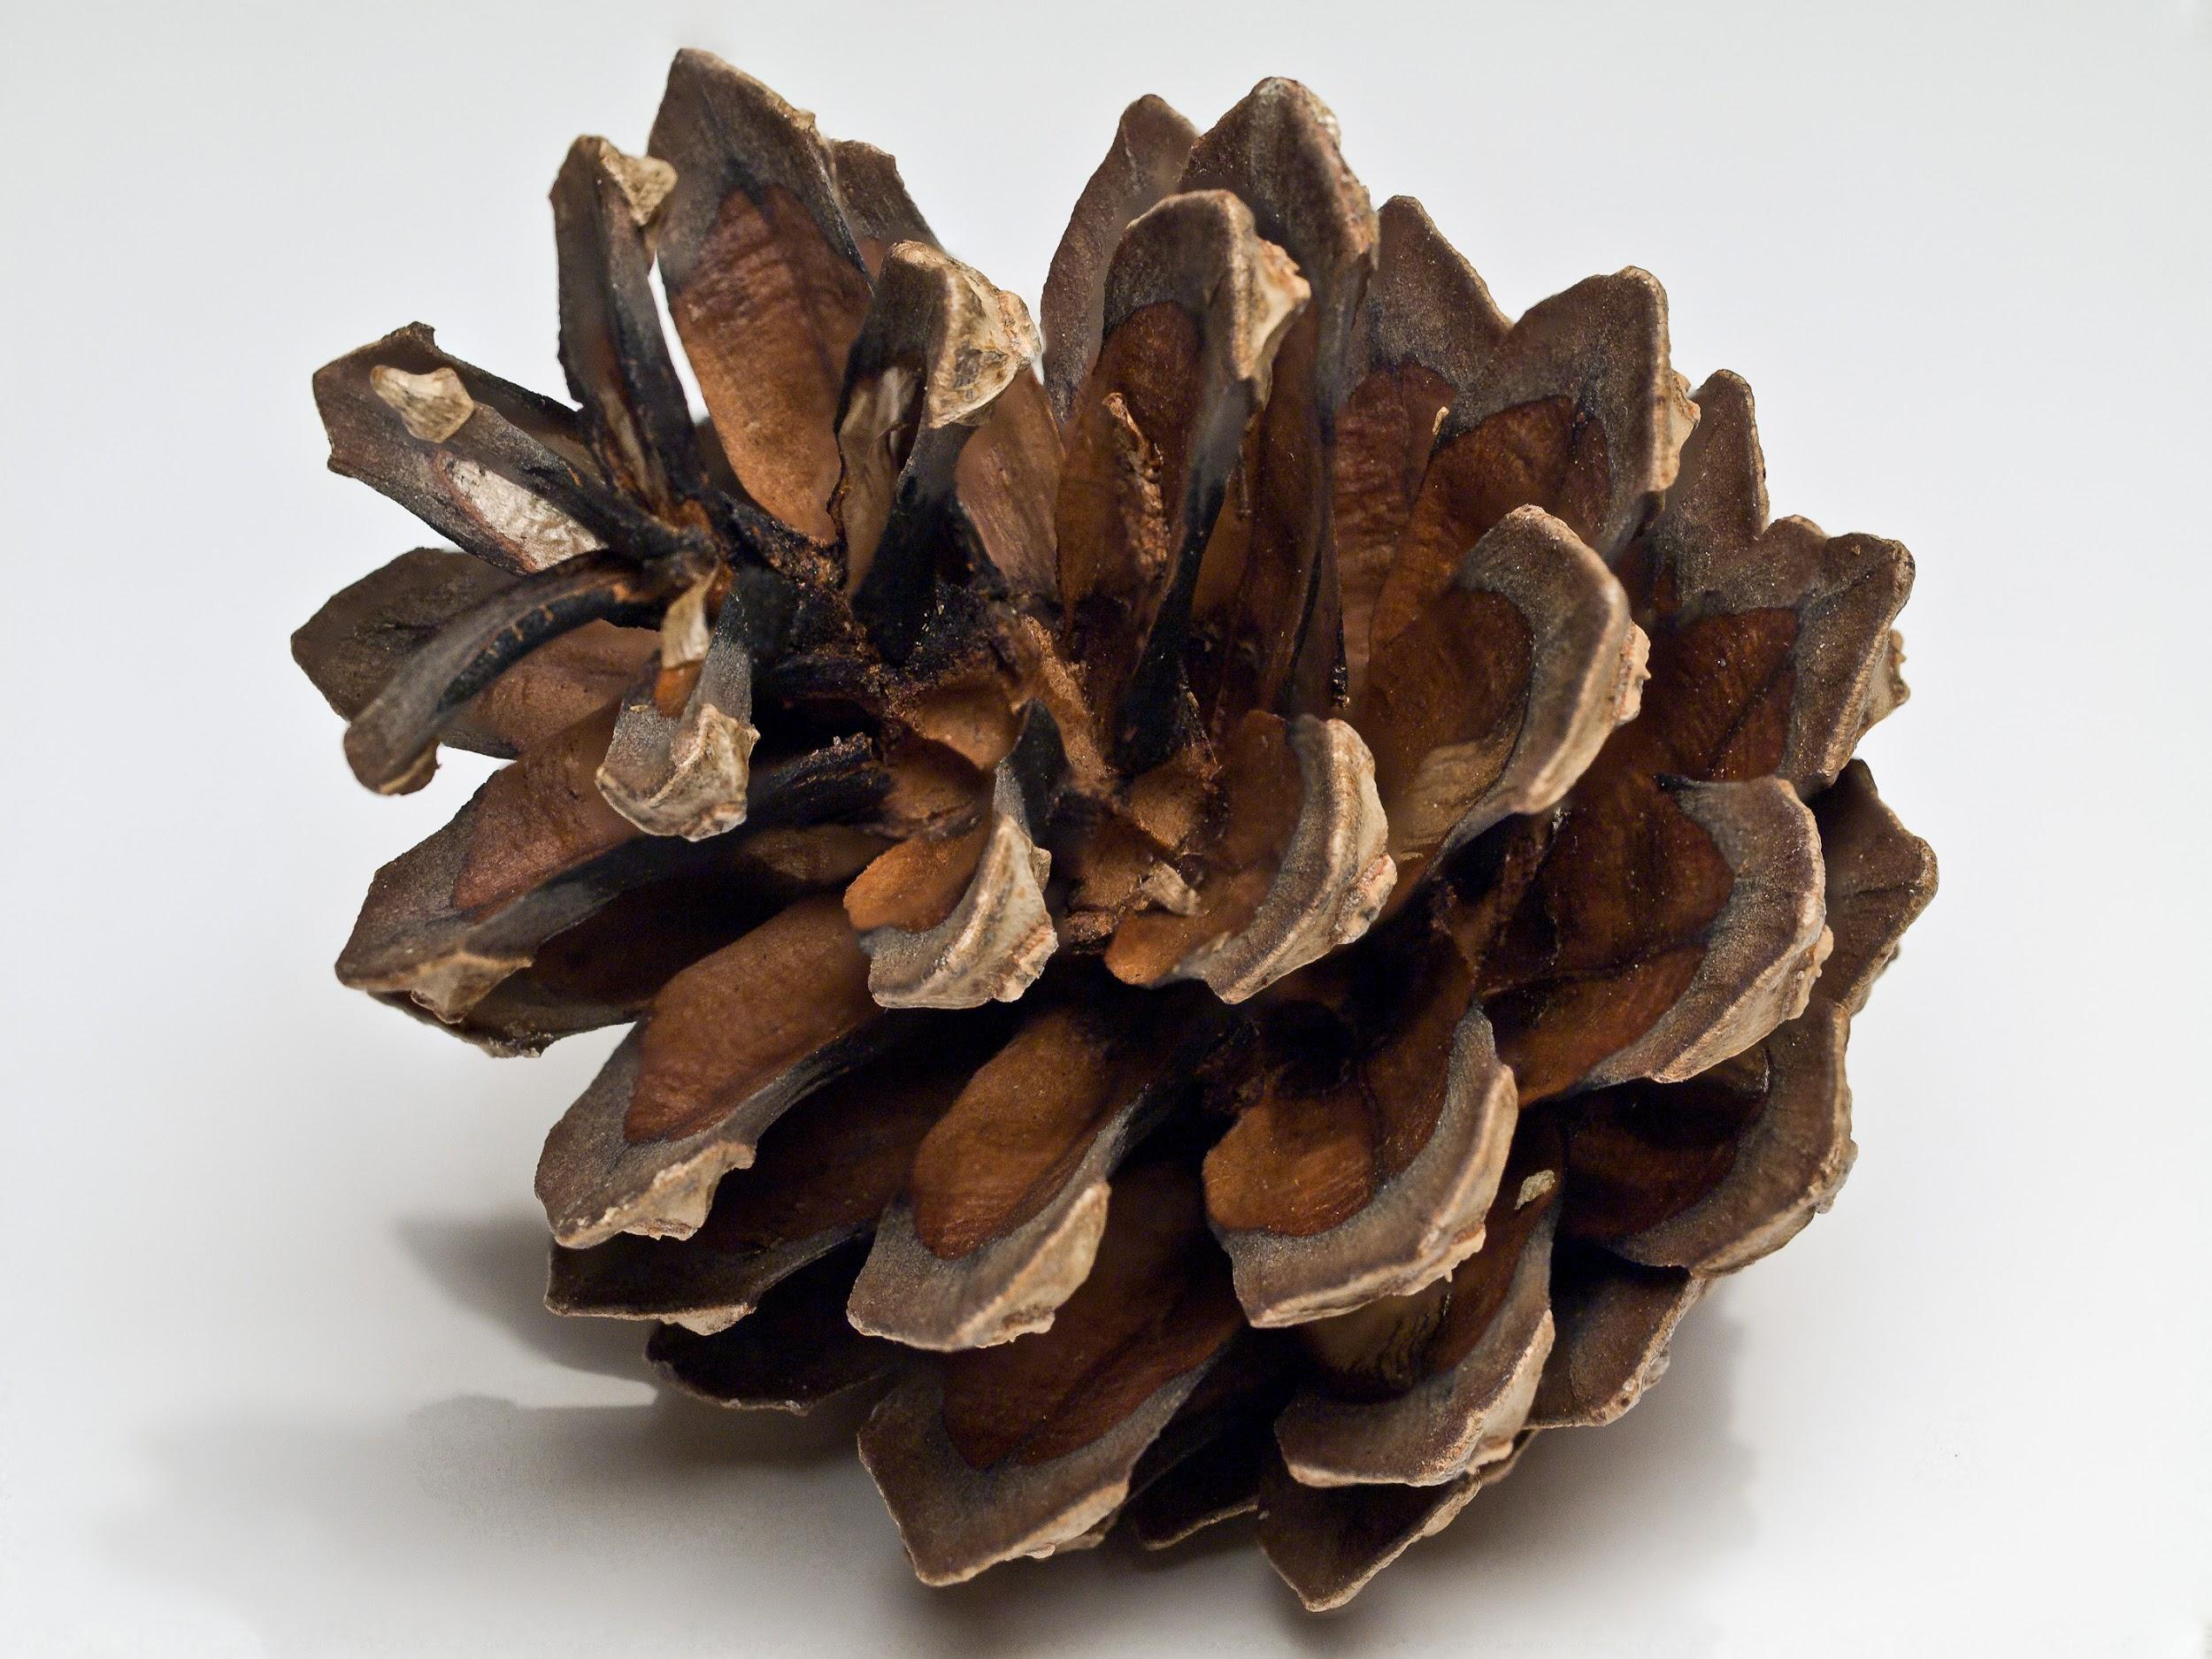
THEN vs THAN: Question # 12
#12 Smaller and paler then the average pinecone.
NO CHANGE
more pale then
paler than
pale than

Slide 27
THAN VS. THEN QUESTION #57
Her initial fatigue and exhaustion turned into exhilaration as she moved through water that was clearer and blue as any she’d swum in before.
NO CHANGE
more blue than
bluer than
bluer then
Than not than….comparing

Slide 28
PARALLEL STRUCTURE
# 41, 57
CLICK HERE for a brief explanation of parallel structure and some examples.
Question #41
He also sent Duncan Yo-Yo Professionals around the country,
demonstrating tricks and sponsoring contests.
NO CHANGE
in order to demonstrate
who demonstrated
yet demonstrating
A is correct NO CHANGE…..verb endings must be the same for parallel structure….ing

Slide 29
Question # 57
Her initial fatigue and exhaustion turned into exhilaration as she moved through water that was clearer and blue as any she’d swum in before.
NO CHANGE
more blue than
bluer than
bluer then
Correct answer is C…..bluer than….adjective ending has to match….clearer and bluer….C not D…..see slide on then/than
Also SINGLE syllable words usually don’t use more but add er to the end

Slide 30
ALWAYS CHOOSE THE SIMPLEST CORRECT EXAMPLE
Be aware, however, of ?’s that ask for the most specific evidence OR descriptive details
QUESTIONS #
ARE ALL EXAMPLES OF CHOOSING THE SIMPLEST WAY TO EXPRESS THE THOUGHT and AVOID REDUNDANCY.
Questions #6, 18, 31, 37, 52, 56 and 66 deal w/ being simple and concise - There are a LOT of ?’s on this area!
#6 : There’s a crucial part of the preparation to get ready for morel hunting...
Answer: J DELETE the underlined portion / preparation and get ready mean the same thing

Slide 31
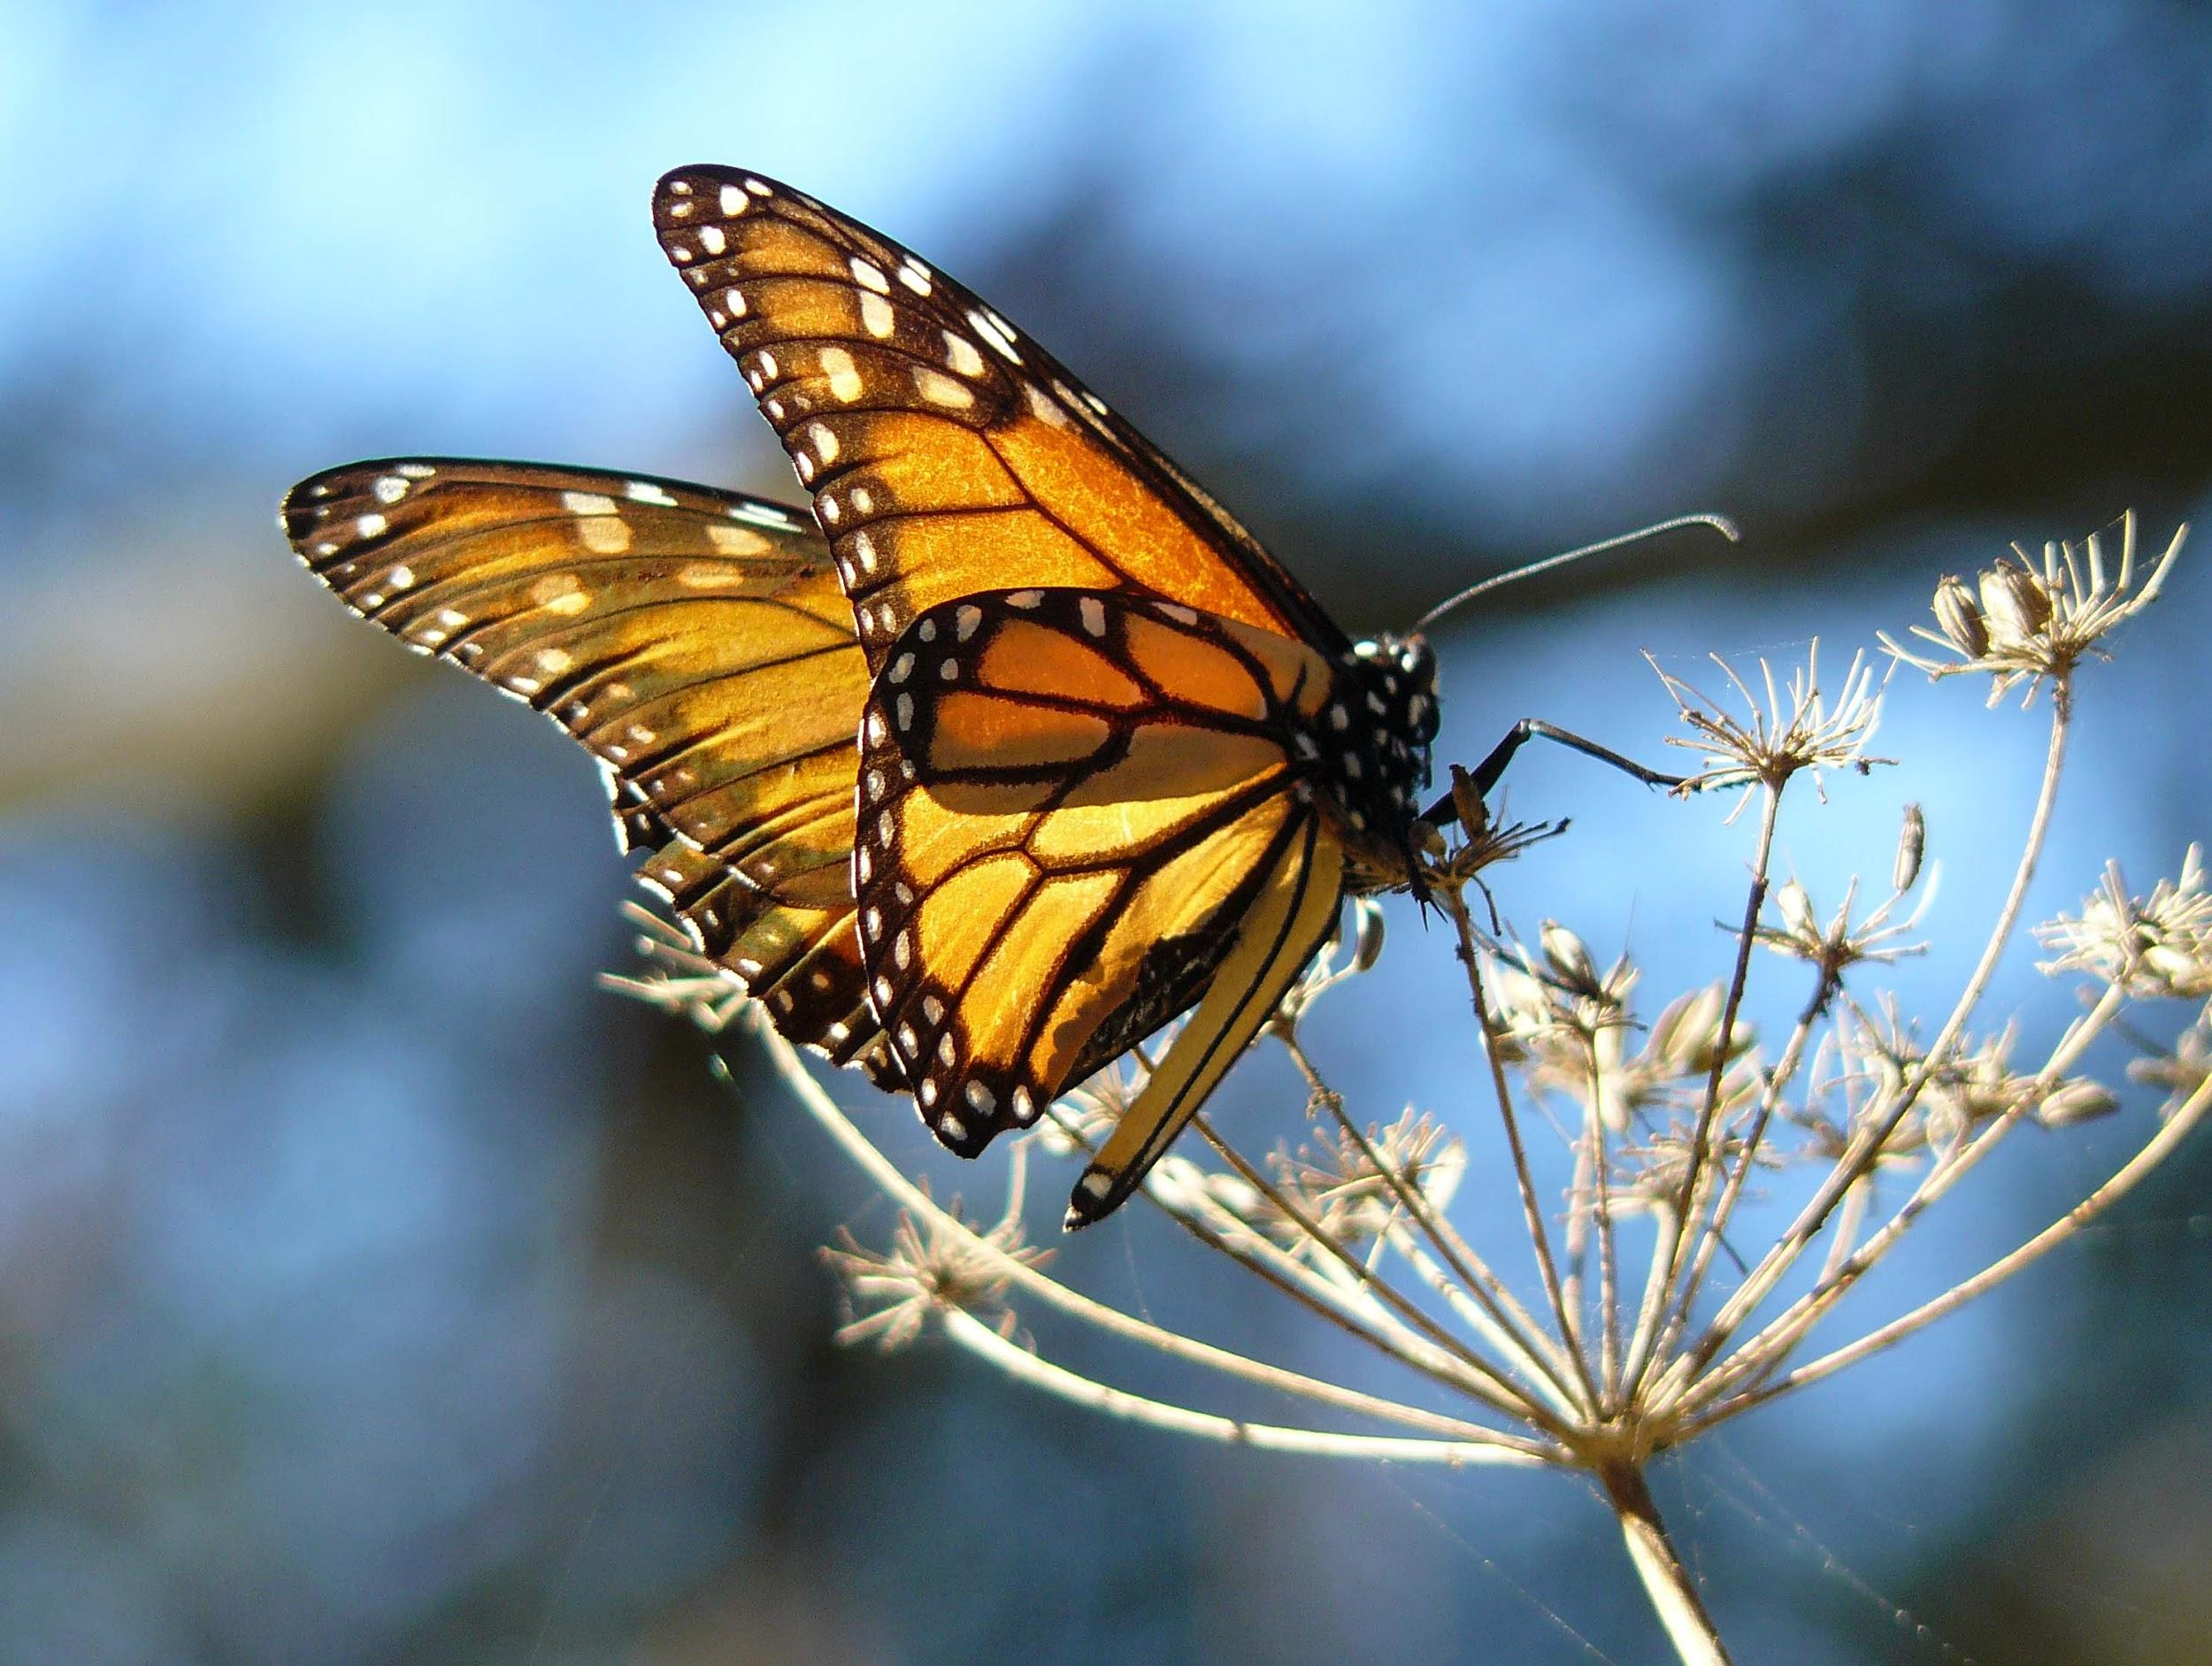
Concise/Simple: Question # 18
#18 In the fall, as daylight and temperature decrease, migrating monarchs begin their long journey south, an extended flight.
F. NO CHANGE
G. south, which is far-reaching
H. south
J. south, which encompasses many miles.

Slide 32

Concise / Simple: QUESTION #31
# 31 Historians speculate that one of the world’s oldest toys is the yo-yo, though they know for sure that the oldest toy is the doll.
NO CHANGE
yo-yo, but it is hard to know for sure, considering the yo-yo’s history
yo-yo, though no one is certain why some ancient yo-yos wer made out of terra cotta, a fragile clay.
yo-yo.

Slide 33
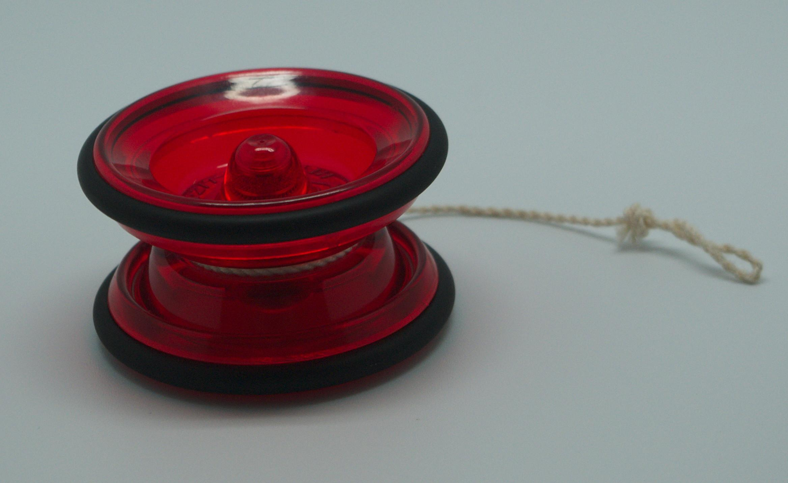
Simple / Concise: #37
#37 Yo-yo technology really progressed substantially by making a leap forward in the 1970’s when designers added weighted rims...
NO CHANGE
advanced as a result of progressively making
jumped ahead and made
made

Slide 34
Simple/ Concise #52
Antarctic seals rely on body fat for warmth, so Cox gained twelve pounds, it was weight that she hoped would keep her warm in the icy water.
F. NO CHANGE
G. she put on weight
H. she gained it so
J. weight
Simplest answer…..don’t need “it was”

Slide 35
Simple/Concise #56
Her initial fatigue and exhaustion turned into exhilaration as she moved through water that was clearer and blue as any she’d swum in before.
F. NO CHANGE
G. exhaustion
H. exhaustion that left her feeling fatigued
J. exhausting fatigue
Simplest choice….exhaustion and fatigue mean the same…..just use exhaustion

Slide 36
Simple/Concise #66
In 1946, he left the Army and began working at a job that was a self-employed photographer.
F. NO CHANGE
G. for himself as
H. as
J. DELETE the underlined portion
simplest phrasing…..”as a self-employed photographer”

Slide 37
TRANSITIONS
#
Determine what transitional word makes the most sense in the context. Look at prior sentence!
Know what transitional words mean. CLICK HERE for an overview of the meaning of transitional words. HANDOUT also available.
Try online activities for additional practice and online quiz.
Questions 21, 25, 27, 33, 47, 54 and 69 deal with transitions

Slide 38

TRANSITIONS / Question # 21
#21 Besides, most monarchs, millions of them across the United States and Canada-- migrate as many as three thousands miles to ...
NO CHANGE
Finally,
However,
Therefore,

Slide 39
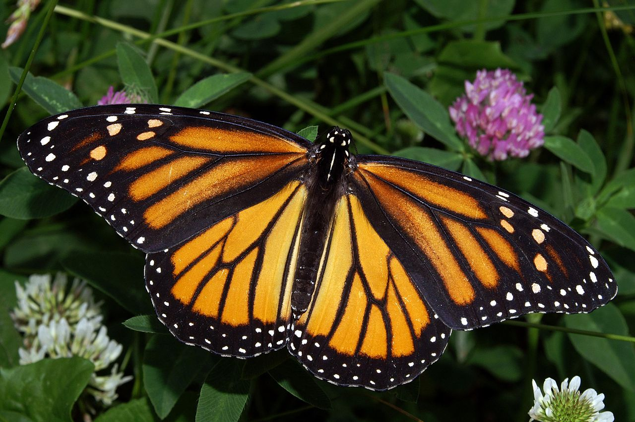
TRANSITIONS / Question # 27
#27 When monarchs that don’t migrate to Mexico live only four to six weeks...
NO CHANGE
IF
WHILE
SO THAT

Slide 40
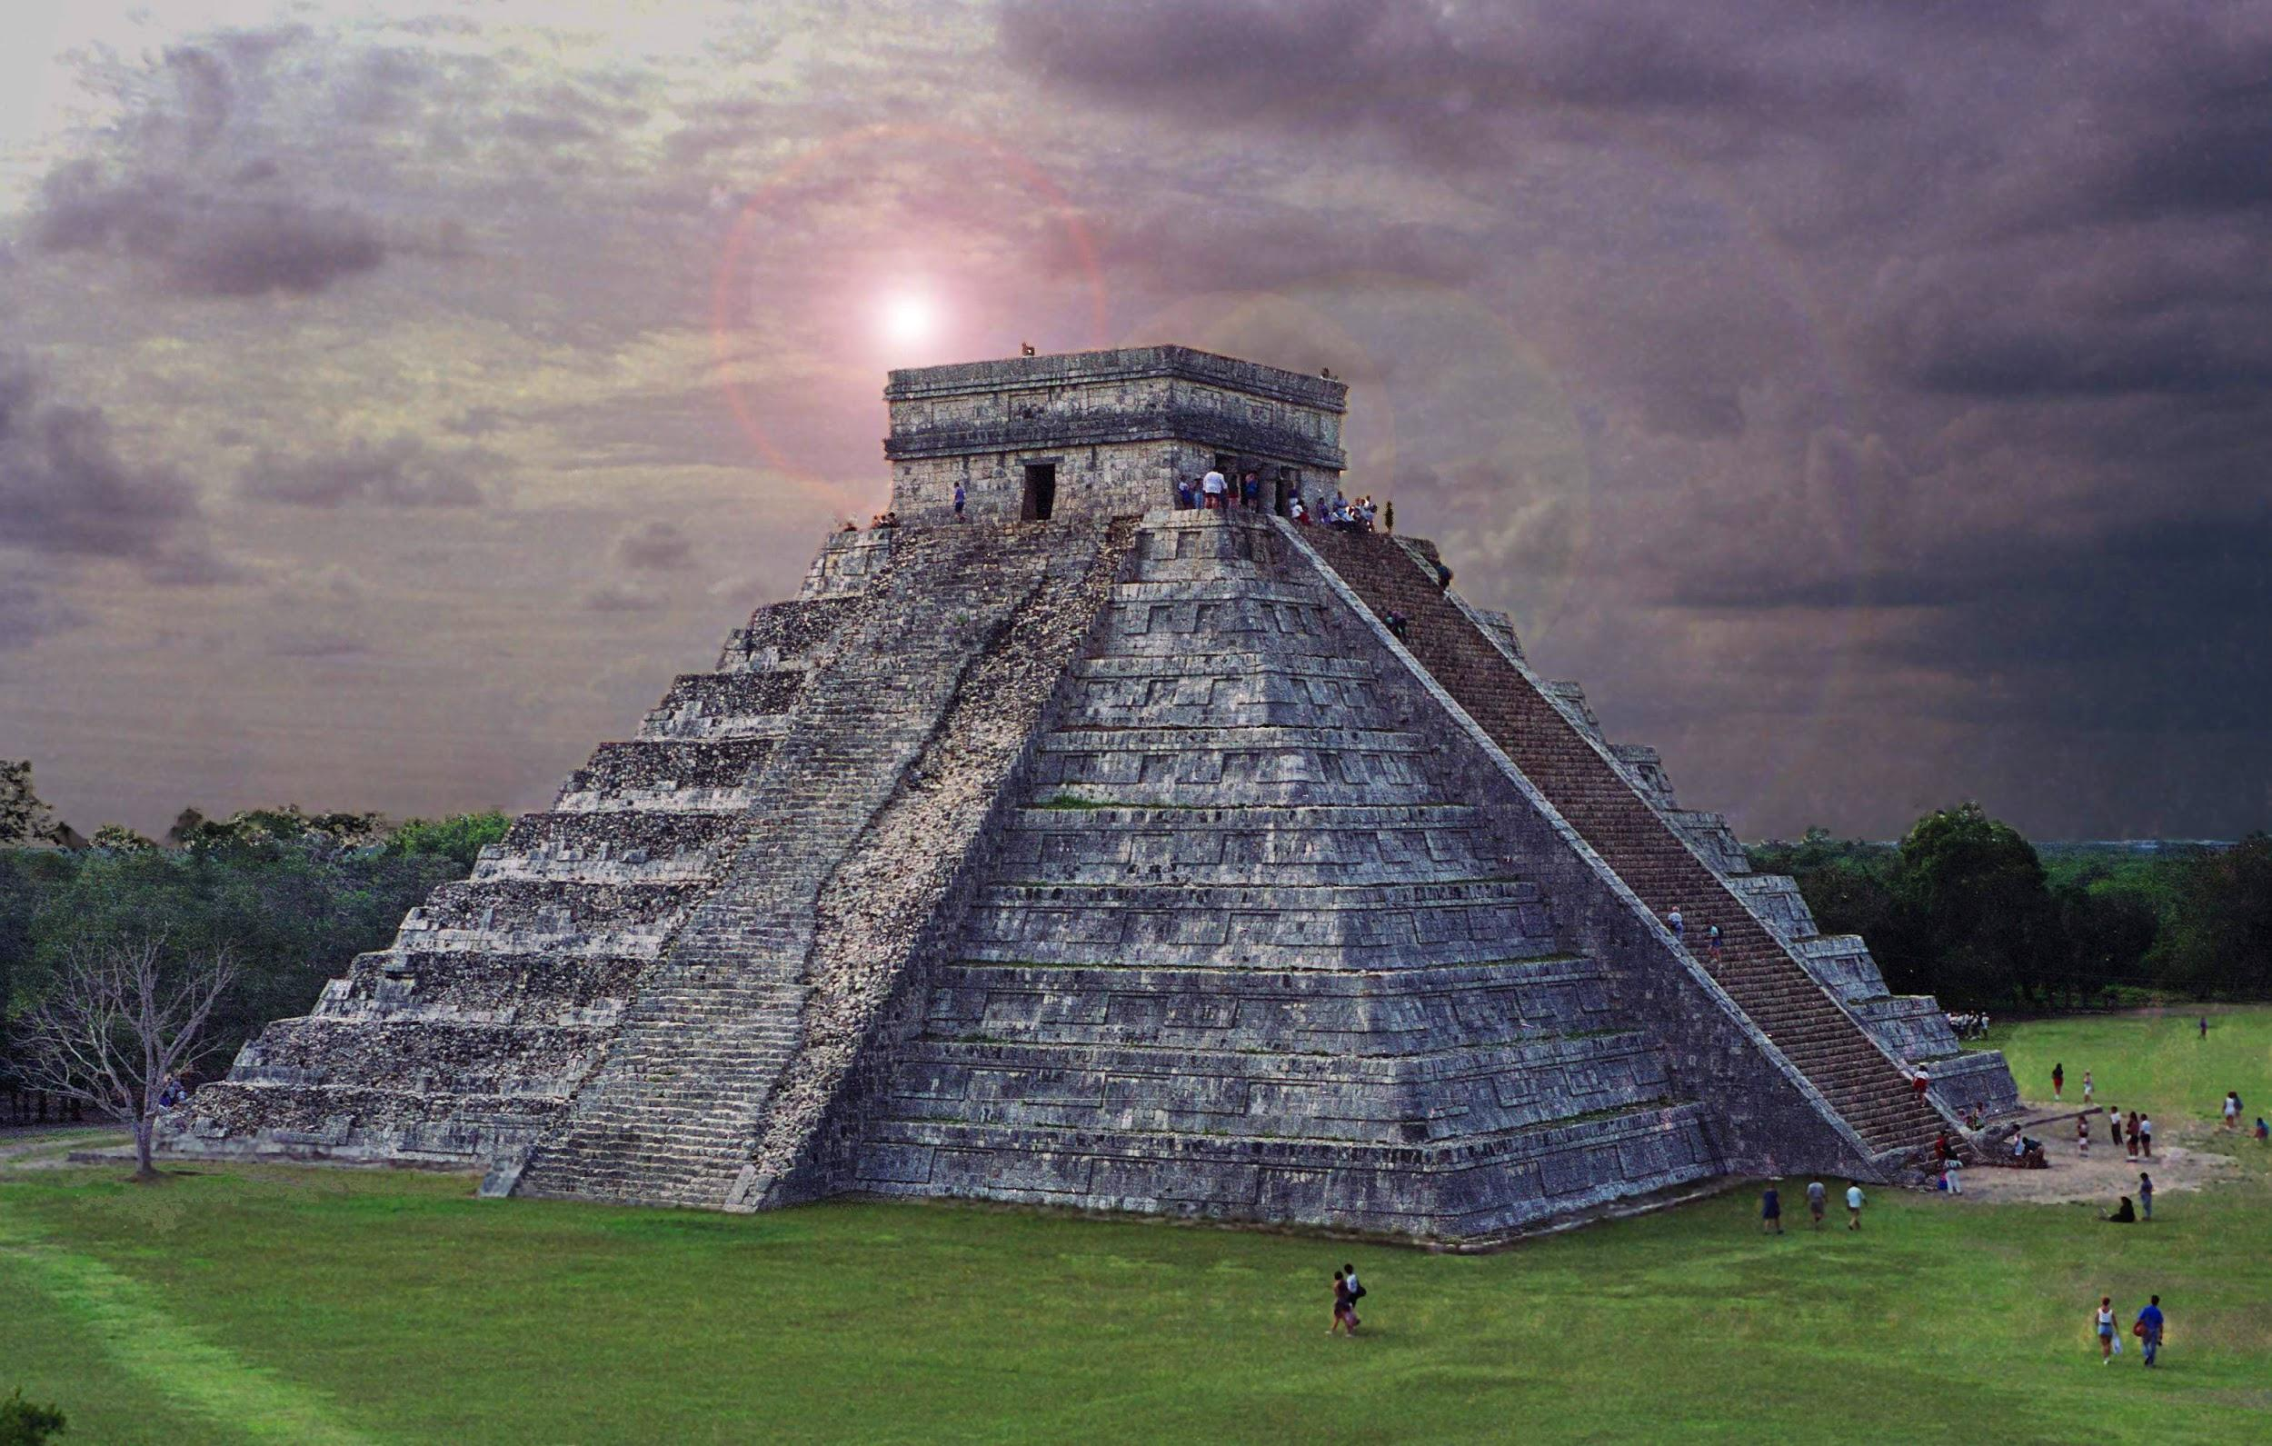
TRANSITIONS / #33
#33 Egyptian temples, if written mention of yo-yos goes back to the fifth century B.C.
NO CHANGE
and
since
because

Slide 41
TRANSITIONS #47
#47 At forty-five, she would of been training for two years for this event, which she hoped her preparations would pay off.
NO CHANGE
and
than
delete the underlined portion
“and” is the correct conjunction

Slide 42
TRANSITIONS #54
#54 In November 2002, a crew of physicians, sailors, and expedition experts, Cox headed for Neko Harbor on the Antarctic Peninsula.
F. NO CHANGE
G. a crew made up of
H. with a crew of
J. Delete the underlined portion
…..need a conjunction “with” in order for the sentence to make sense

Slide 43
TRANSITIONS #69
Withers often traveled with and photographed such historic figures as Martin Luther King Jr., Medgar Evers, and James Meredith.
#69. Which of the following alternatives to the underlined portion would NOT be acceptable?
such historical figures as
historical figures such as
such historic figures
historic figures like
C. would not be correct…...need a conjunction on the end of the phrase to make the transition - TRICK QUESTION asking which is NOT correct!!

Slide 44

AGREEMENT
#
Subject and Verbs must agree AND
Subjects and Pronouns must agree
Reminders:
singular verbs end in s
He dances
They dance
Also don’t be distracted by words that come after the subject

Slide 45
Question # 71
For instance, his photos of Memphis’s Beale Street jazz and blues musicians includes the likes of B.B. King, Aretha Franklin, and Elvis Presley.
NO CHANGE
does include
including
include
D is correct. subject and verb must agree…..you have a plural subject photos the verb you use must agree…….include is the verb that agrees

Slide 46
Verb Tense #38
#38 The American craze for the toy began when the entrepreneur Donald Duncan saw a demonstration of Flores’s new yo-yo.
F. NO CHANGE
G. begins
H. begun
J. had began
Verb tense must make sense in the sentence. Need began which is past since this happened in the past.

Slide 47
Verb Tense #46
#46 At forty-five, she would of been training for two years for this event, which she hoped her preparations would pay off.
F. NO CHANGE
G. had
H. have
J. had to of
G. “had” is the correct tense, past tense…..”would of” isn’t a correct verb it would be “would have” but the tense isn’t correct

Slide 48

COMPLEX SENTENCES
Complex sentences have:
a dependent clause (otherwise known as a subordinating clause) which can NOT stand alone. Dependent clauses are DEPENDENT (like a baby is dependent on adults) and must be joined w/ an independent clause or they are a FRAGMENT
+
an independent clause which is a complete sentence that CAN stand alone

Slide 49


Complex Sentences Continued
If the DEPENDENT clause comes FIRST, a comma IS NEEDED
If the DEPENDENT CLAUSE comes second, a comma is NOT needed.
Because I love math, I am going to be an engineer.
I am going to be an engineer because I love math.

Slide 50
#Question 62
Using his hometown as his base and documenting the key people and events of the world in which he grew up, observed, and learned.
F. NO CHANGE
G. base. Withers documented
H. base, Withers documented
J. base, documenting
H is correct….You need to have a comma after the introductory clause…...also need to change the verb tense to make it parallel

Slide 51

Check your Answers
How did you do on 3, 5, 11, 30, and 34?
ALL of these questions ask you to select answers that provide specific evidence

Slide 52

CHECK your Answers:
How did you do on 1 and 36?
These questions are tricky for most people they are asking for what is incorrect (i.e. least acceptable, NOT acceptable, etc.)
Watch out for questions like this.

Slide 53

CHECK out online links on Ms. Kaminski’s web page for more review, clarification, and interactive online activities including ACT Prep Sites!
Also taking more SAMPLE tests also help
Sample tests available
from us
Also check out the ACT
books in the LMC

